Slide 2
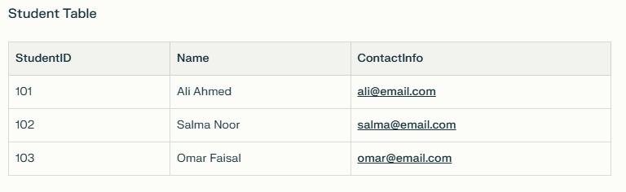
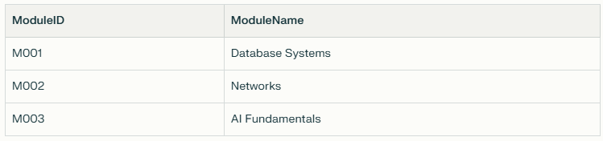
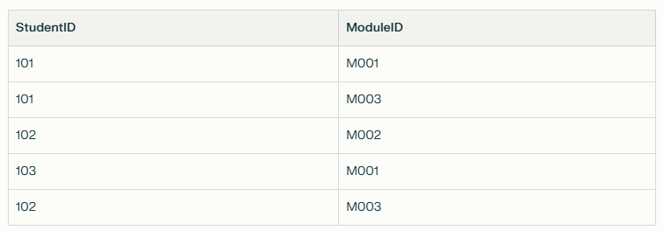
Tutorial
Notes:
StudentID in the Enrollment table is a foreign key linking to StudentID in the Student table.
ModuleID in the Enrollment table is a foreign key linking to ModuleID in the Module table.
In the Enrollment table, both StudentID and ModuleID together form a composite primary key.
This means the combination of StudentID and ModuleID must be unique in each row.
It prevents a student from enrolling in the same module more than once.
Each column (StudentID, ModuleID) is also a foreign key referencing the primary key in the Student and Module tables, respectively.

Slide 3
Data Types & Practical Examples
Common Data Types:
String: For names, descriptions, codes (e.g., VARCHAR(50), CHAR(10))
Integer: For whole numbers (e.g., INT, SMALLINT)
Float/Decimal: For fractions (e.g., DECIMAL(8,2), FLOAT)
Boolean: For true/false (e.g., BOOLEAN)
Date/Time: For dates/time/timestamps (e.g., DATE, TIMESTAMP)

Slide 4
Key Constraints
Types of Constraints:
NOT NULL: Must have a value (cannot be empty)
UNIQUE: Must be different for every row (e.g., username)
PRIMARY KEY: Uniquely identifies each row (often an ID)
FOREIGN KEY: References the primary key in another table
Domain Constraint: Only certain values allowed (e.g., Gender is 'M' or 'F')

Slide 5
